Slide 1
MA Journey – Our Story
Melbourne Australia – Christian Convention – May 2013
Joe in Singapore – July 2013
Taiwan Convention – Nov 2013
Joined as UFO at opening of EMP Singapore – 17 Dec 2013
Miami World Conference – Feb 2014
Market Singapore Official Opening – 18 Sep 2014
Market Malaysia Official Opening – 12 Sep 2017

Slide 2
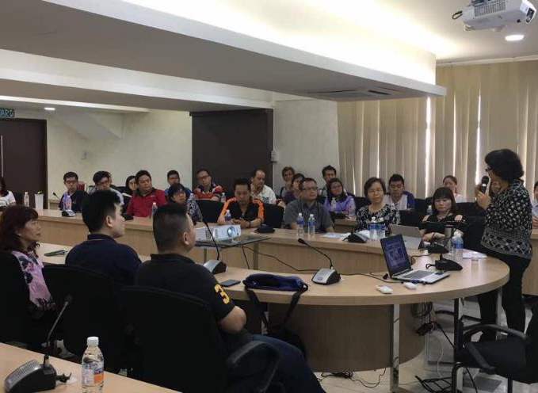
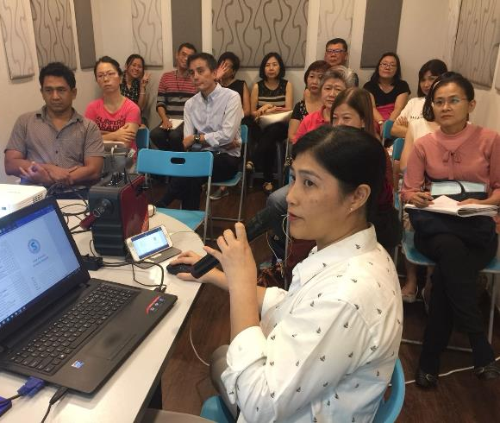
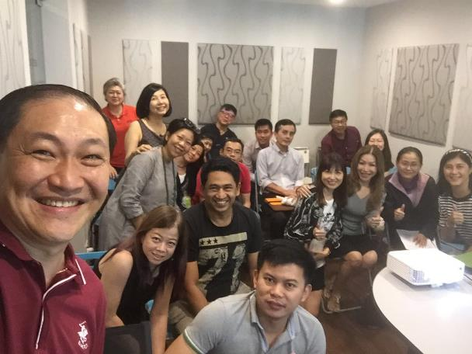
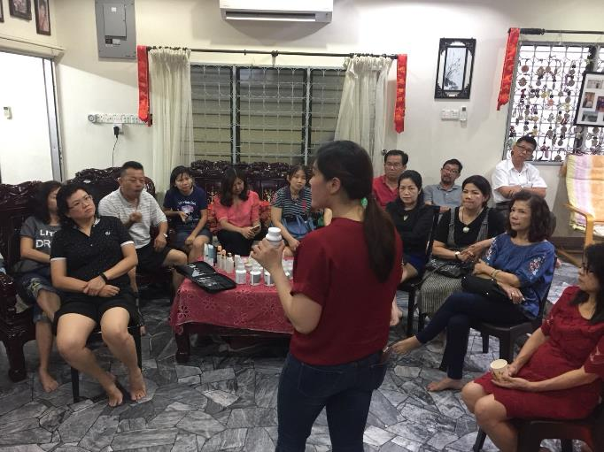
Team Coring
HBP & Training

Slide 3
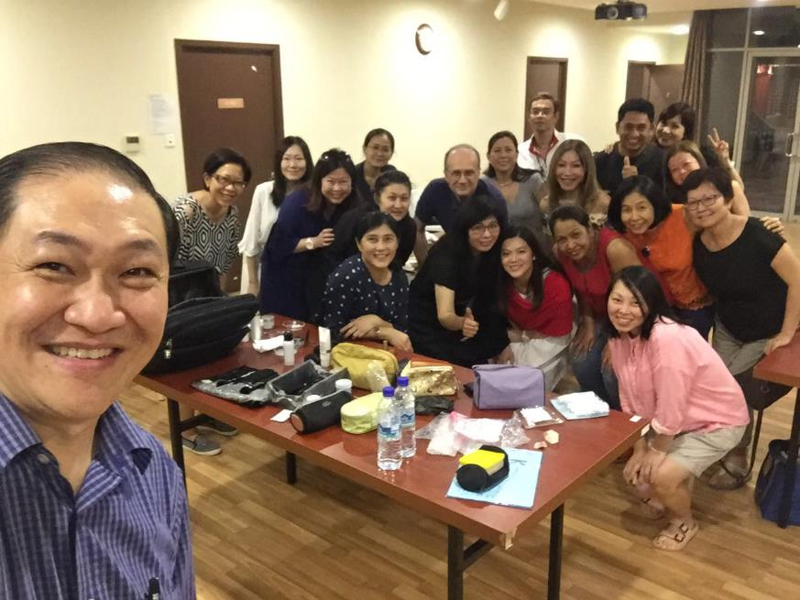
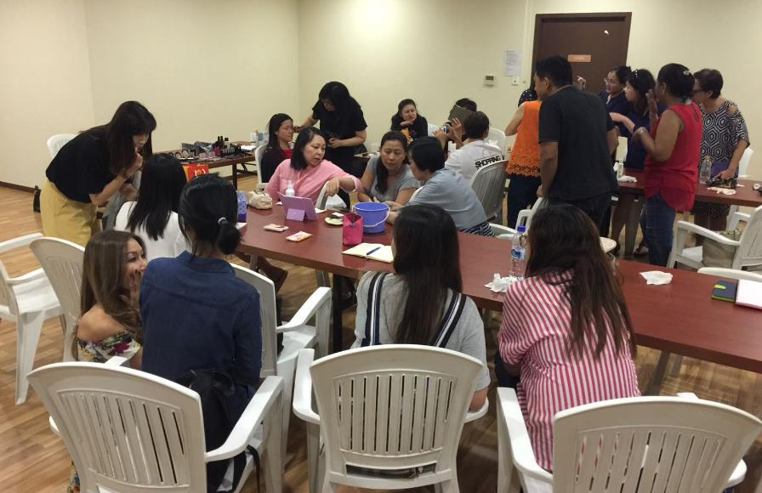
Motives
Home Party

Slide 4
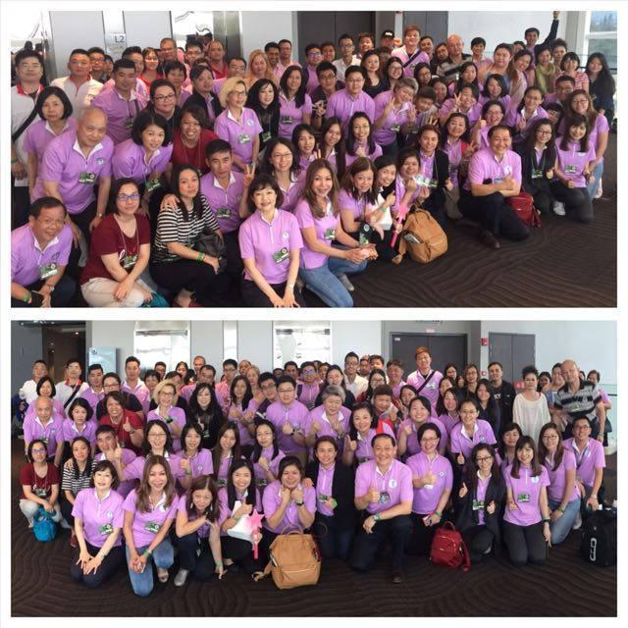
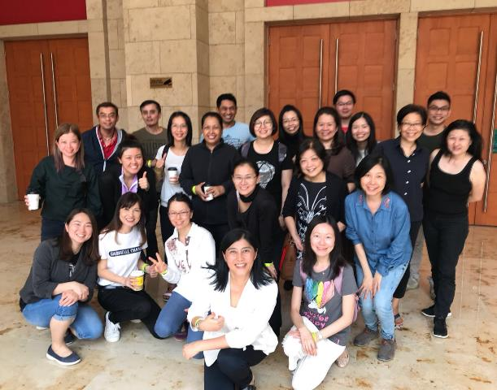
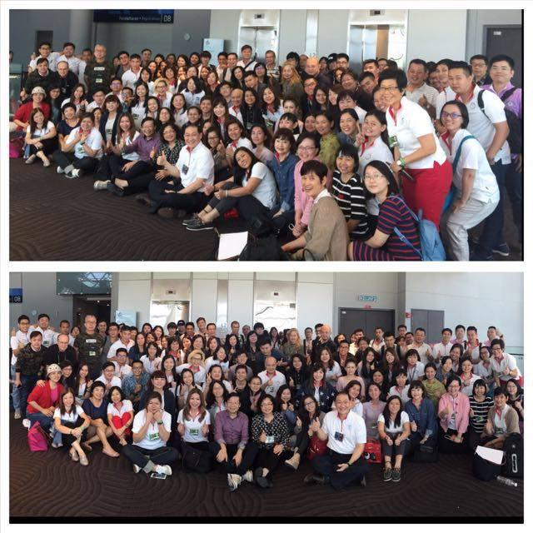
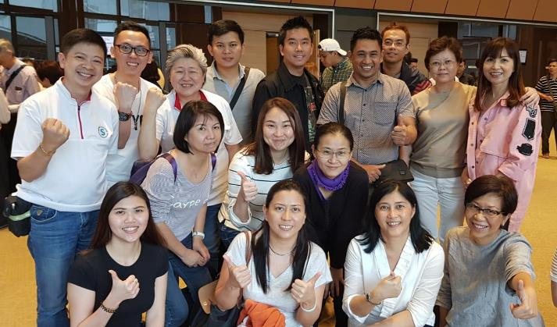
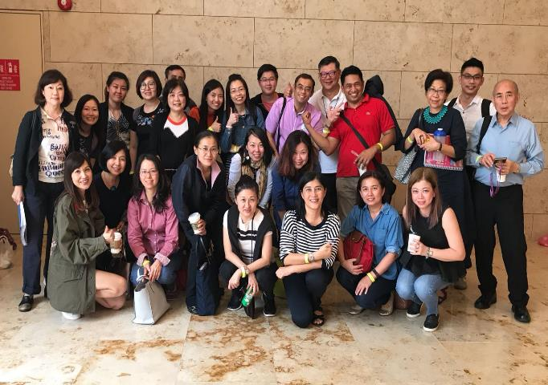
Emphasis on Attending
Key GMTSS Events

Slide 5
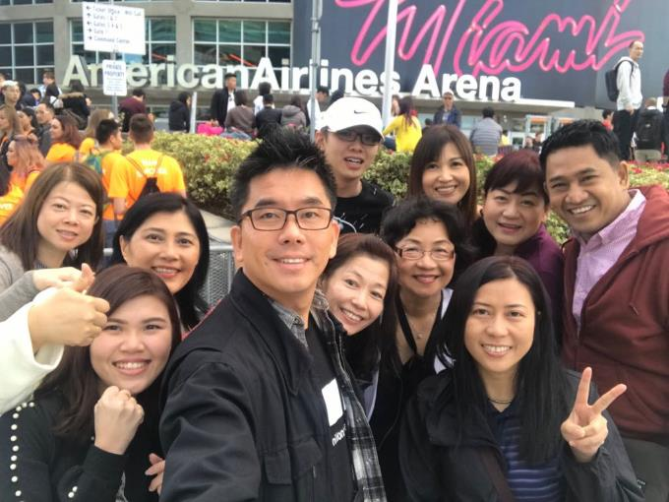
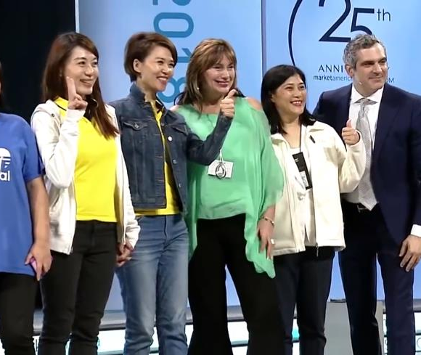
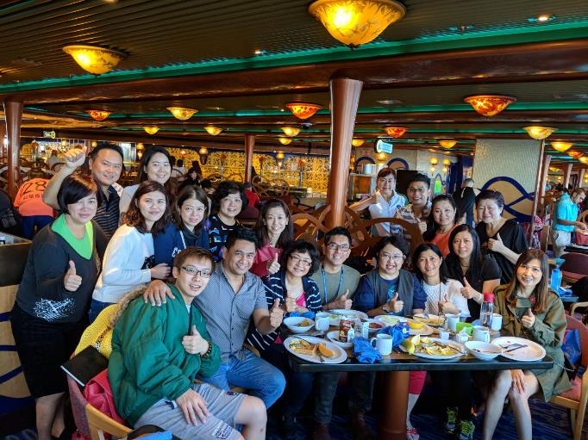
Miami World Conference 2018

Slide 6
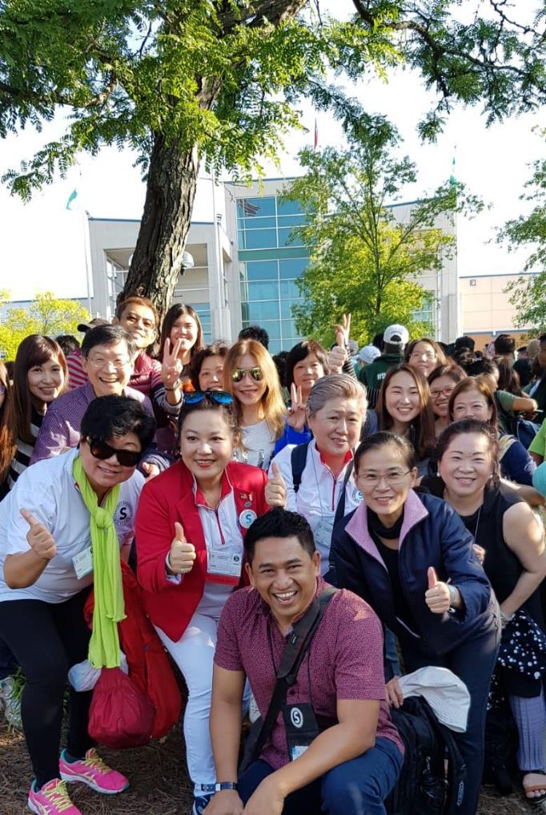
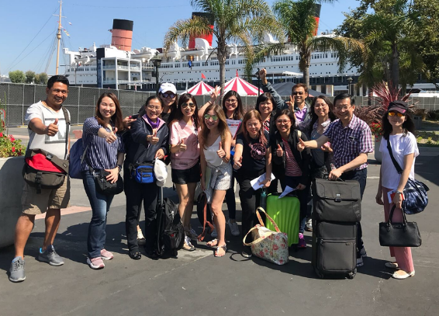
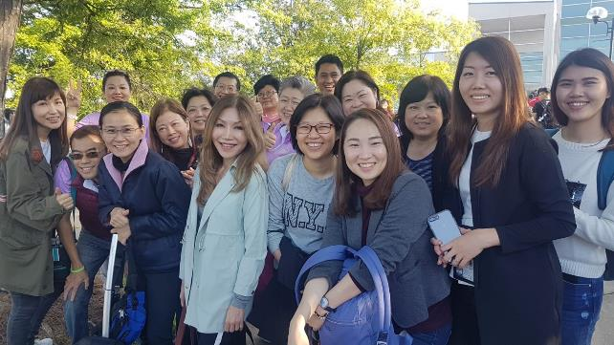
Greensboro International Convention 2018

Slide 7
Strategies for Success
5 KEY STRATEGIES
Recruiting good quality people – Leaders & Go Nows
Fully convert to MA Products – BVs & IBVs
Retailing (Base: 10 customers)
Effective Duplication – Mentoring, Coaching, Team Coring
Attending Key Events (Are your team members with you?)

